Slide 1

CS 53D Intro To Computer Forensics
Tim Ryan
ryantimothy@fhda.edu

Slide 2
CS53D: Intro to Computer Forensics
Week 3 Agenda
Course and Assignment Review
Quiz #1 Statistics
Lab Development (NDG, NSF, DoL)
Virtual Box Info
Deepfake Forensics
Facial Recognition Forensics
Association of Computing Machinery (ACM)
Lab #9 Browser Forensics
Lab #14 Email Forensics

Slide 3
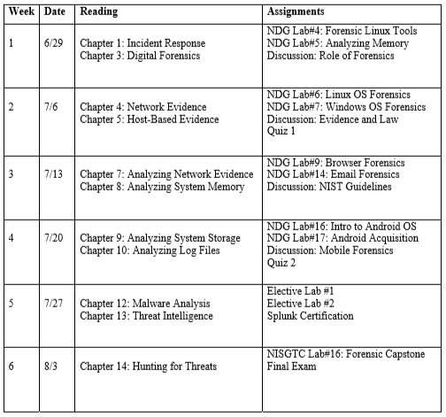
Course Outline - Subject to Minor Changes

Slide 4
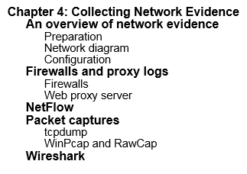
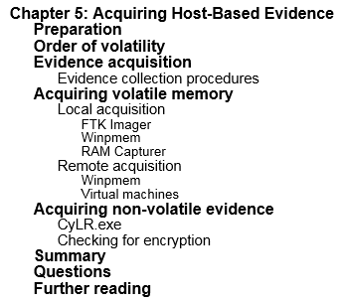
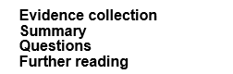
Week 2 Reading Assignment

Slide 5
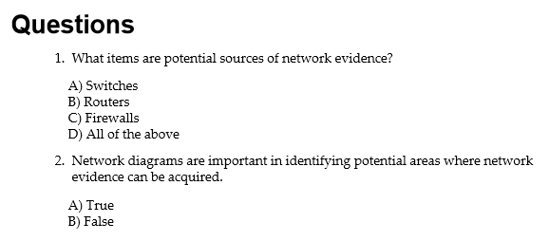
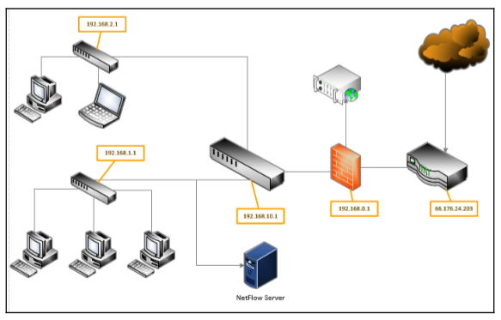

Slide 6
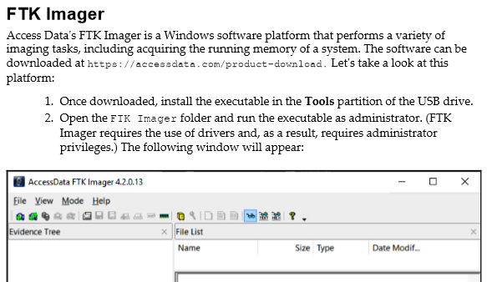
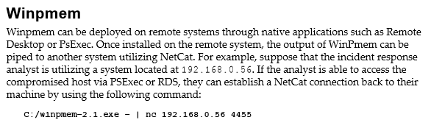

Slide 7
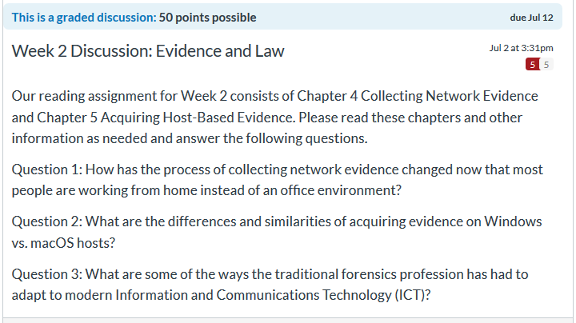
Great Responses, Thanks!

Slide 8

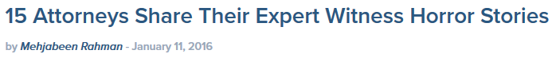
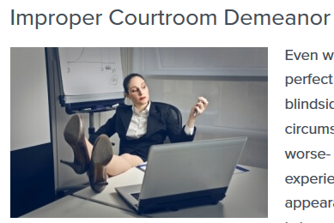
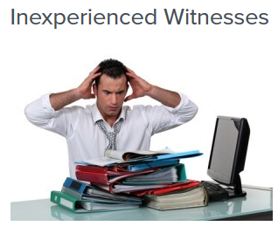

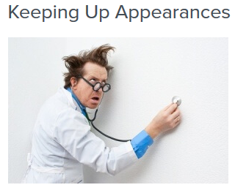
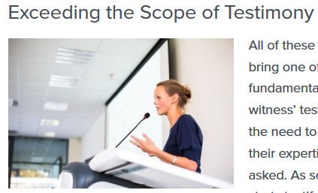
Source: https://www.theexpertinstitute.com/15-attorneys-share-their-expert-witness-horror-stories/

Slide 9
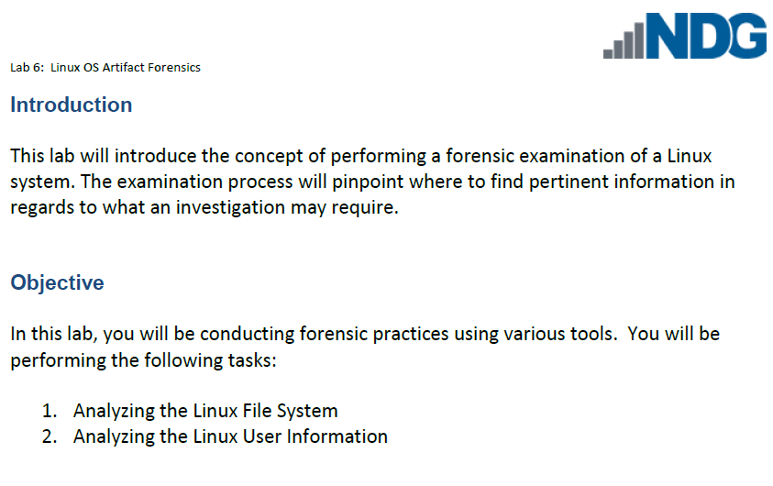

Slide 10
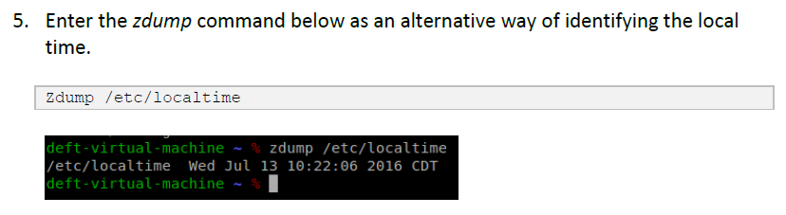
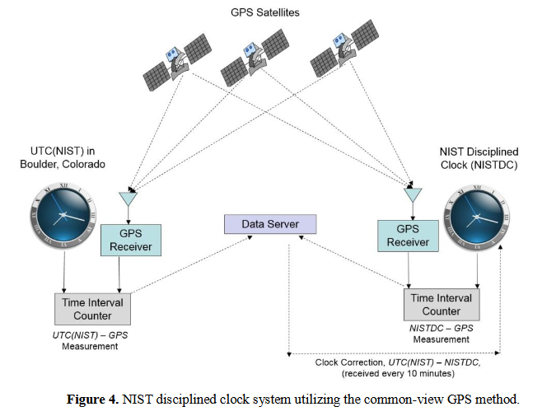

Slide 11
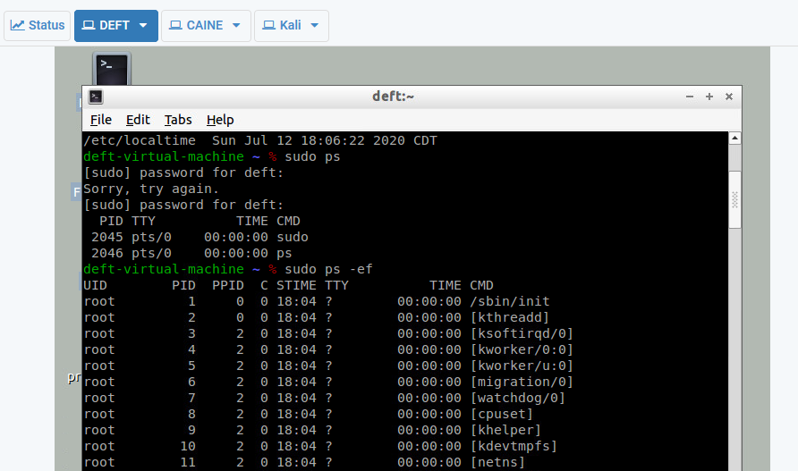
Note Difference Between ps and ps -ef

Slide 12
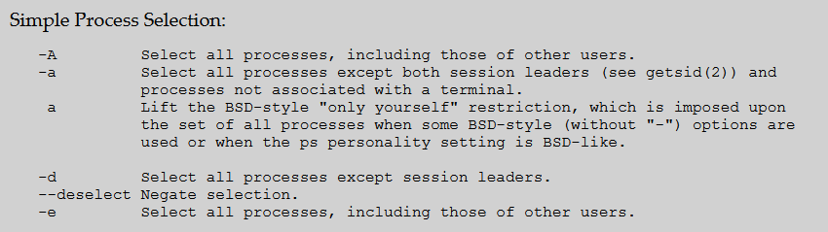

Reference: https://ss64.com/bash/ps.html

Slide 13
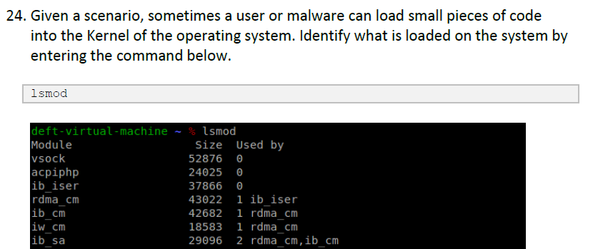
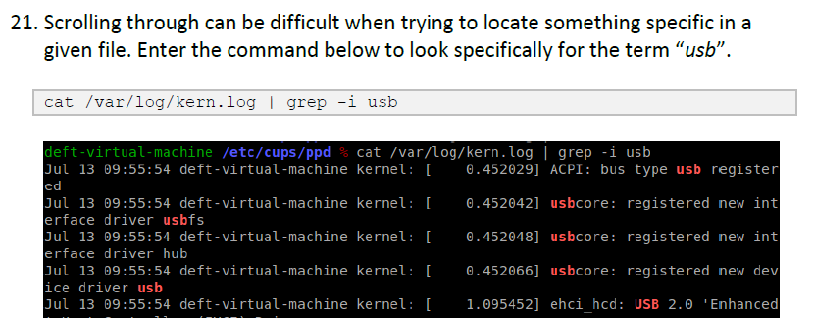

Slide 14
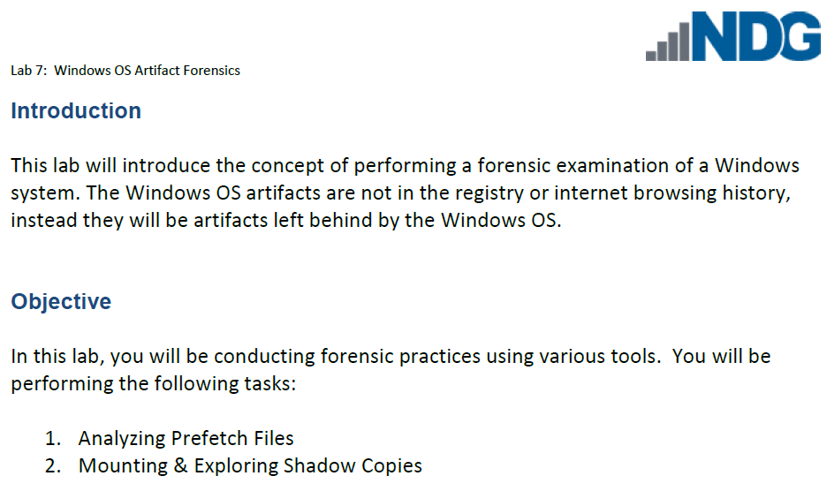

Slide 15
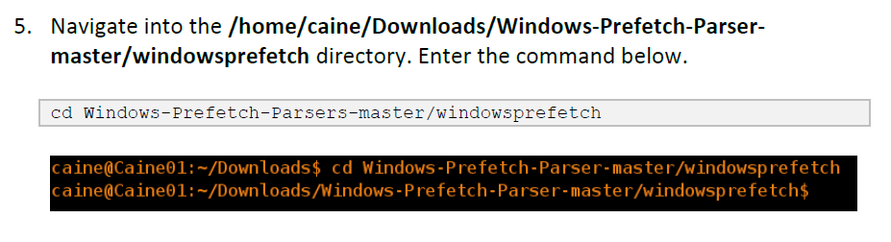
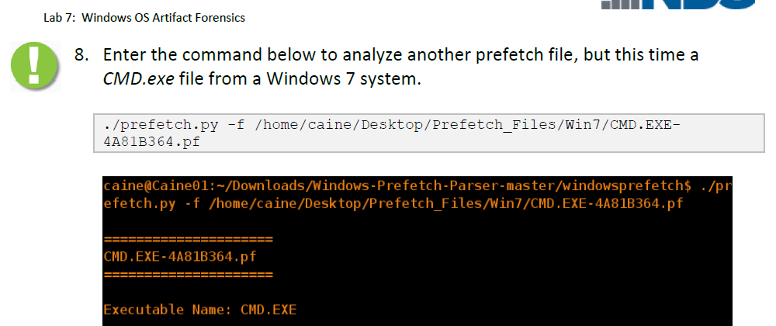

Slide 16
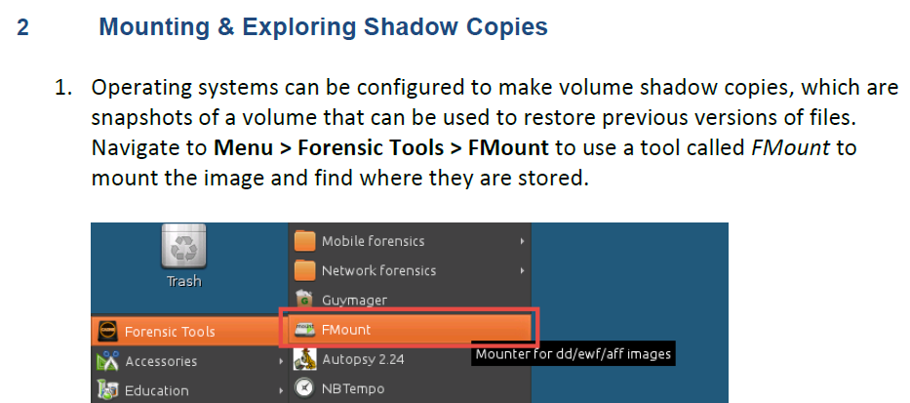
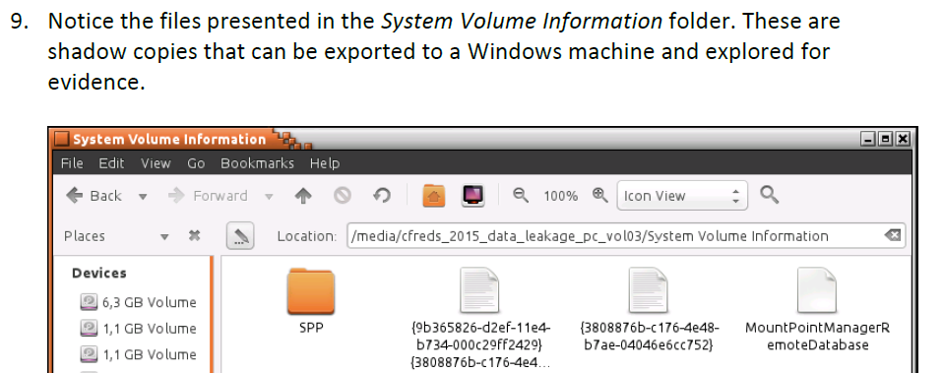

Slide 17
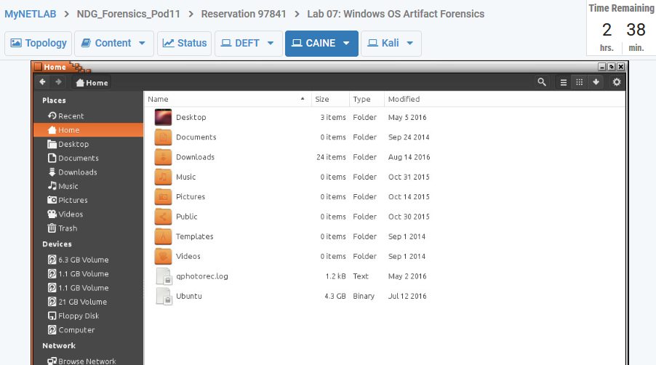

Slide 18
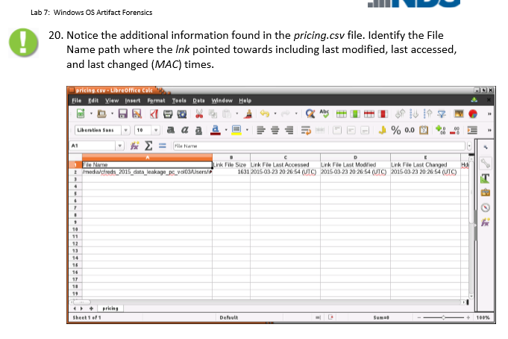

Slide 19
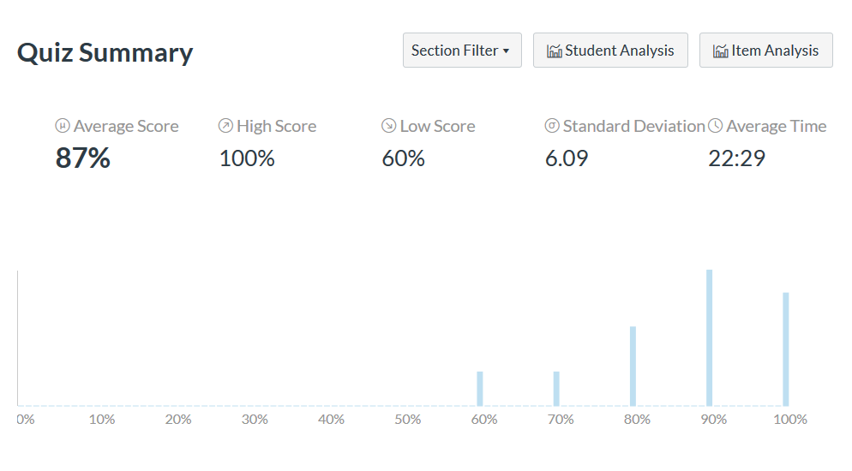
Quiz Statistics - 2020

Slide 20
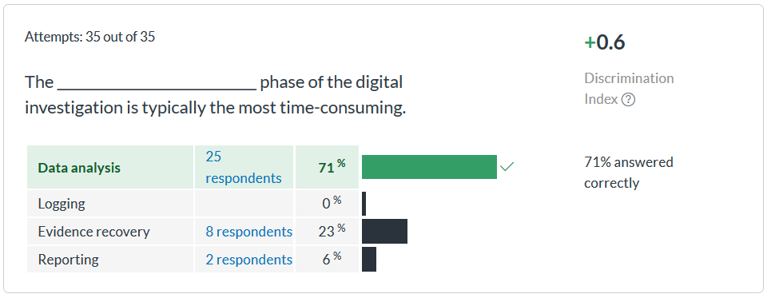

Slide 21
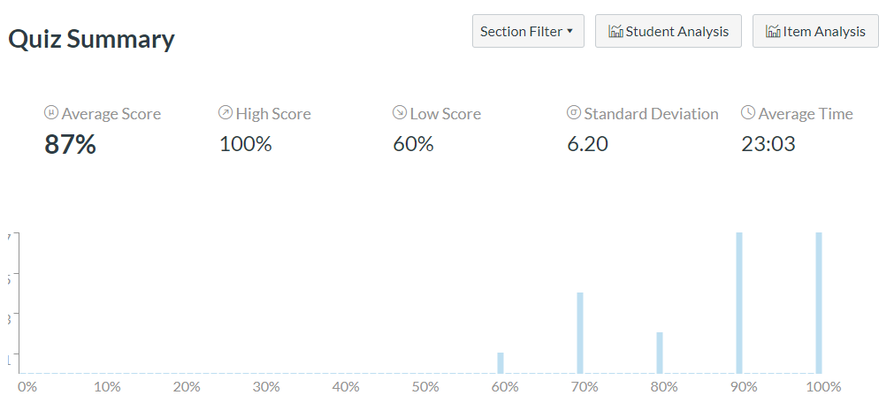
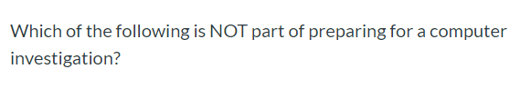
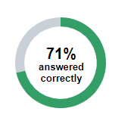
Quiz Statistics - 2019

Slide 22
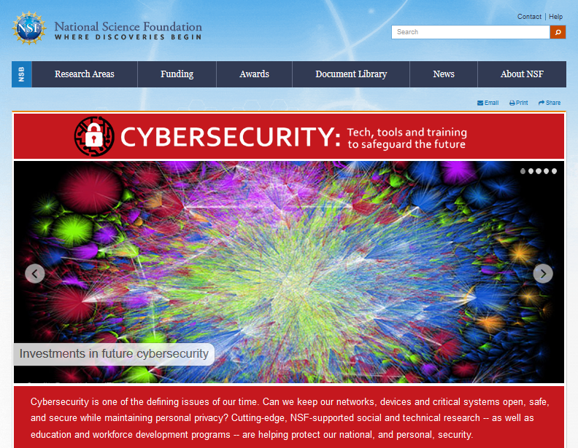
Source: https://www.nsf.gov/news/special_reports/cybersecurity/index.jsp

Slide 23
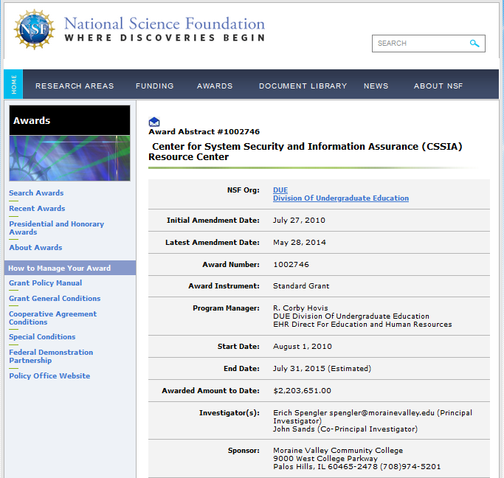
Source: https://www.nsf.gov/awardsearch/showAward?AWD_ID=1002746&HistoricalAwards=false

Slide 24
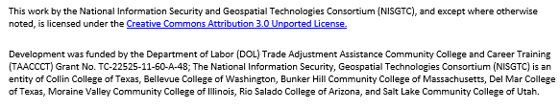
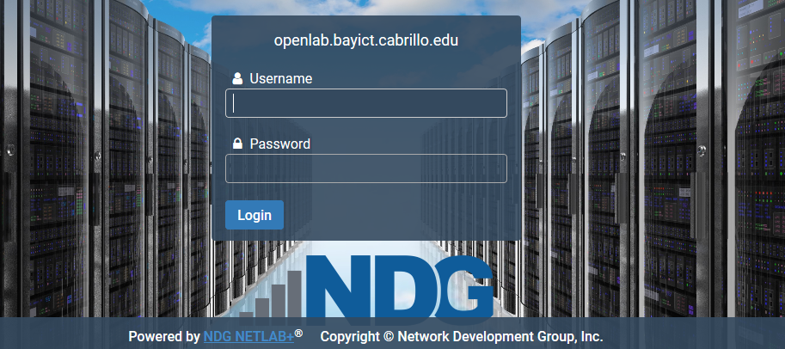
NISGTC – Dept. of Labor Grant
NDG – Industry Partner

Slide 25
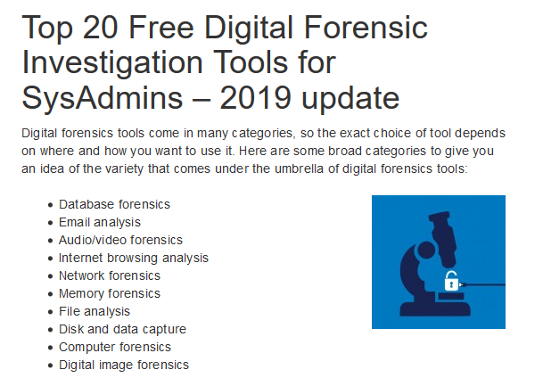
Source: https://techtalk.gfi.com/top-20-free-digital-forensic-investigation-tools-for-sysadmins/

Slide 26
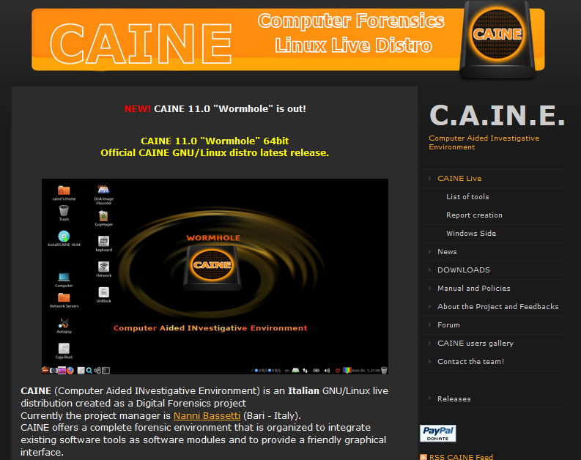
https://www.caine-live.net/

Slide 27

Download: https://www.virtualbox.org/wiki/Downloads

Slide 28
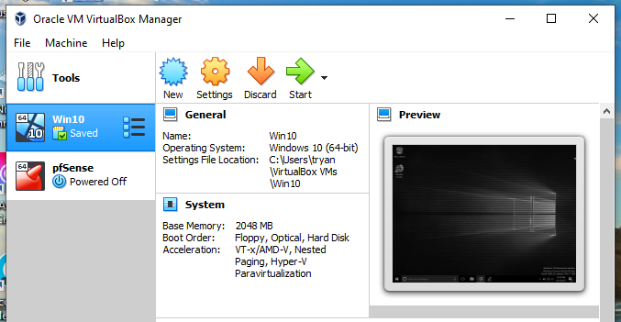
Existing Virtual Machines

Slide 29
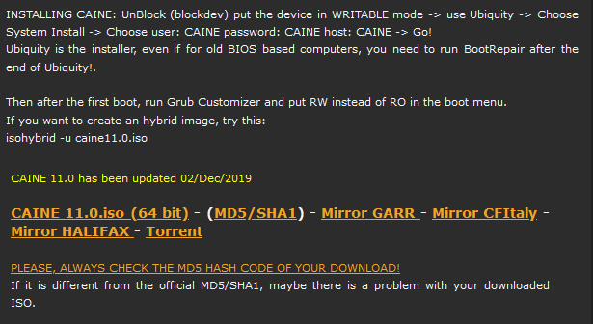
Download CAINE11.0.iso (4.2GB)

Slide 30
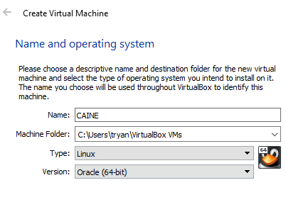
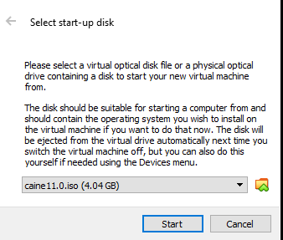
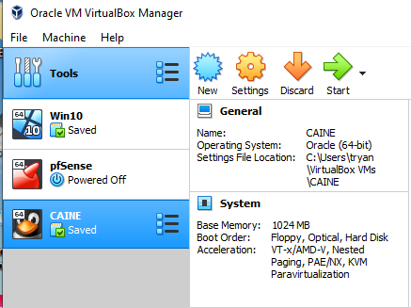
Run As Administrator, Create New VM, Install CAINE
https://www.virtualbox.org/wiki/Documentation

Slide 31
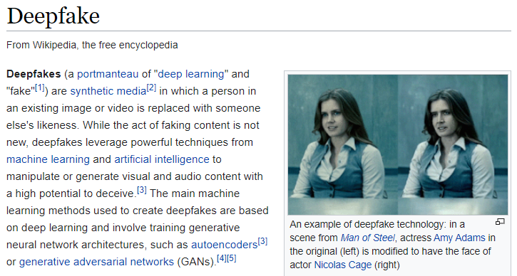
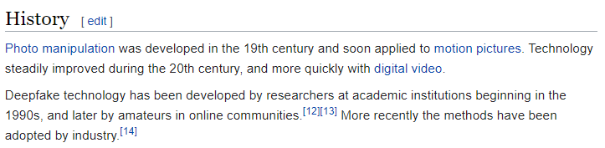
Source: https://en.wikipedia.org/wiki/Deepfake

Slide 32
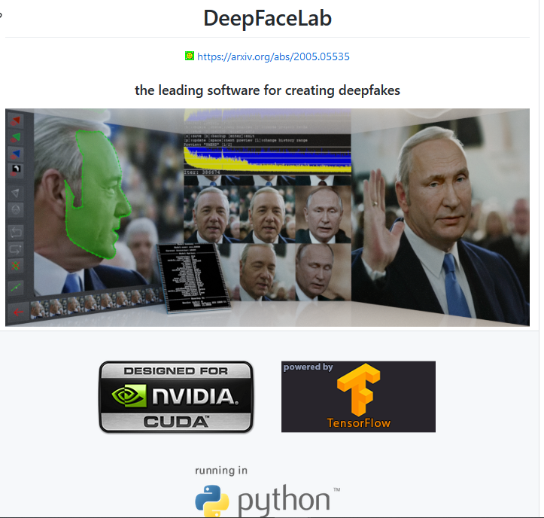
Source: https://github.com/iperov/DeepFaceLab

Slide 33
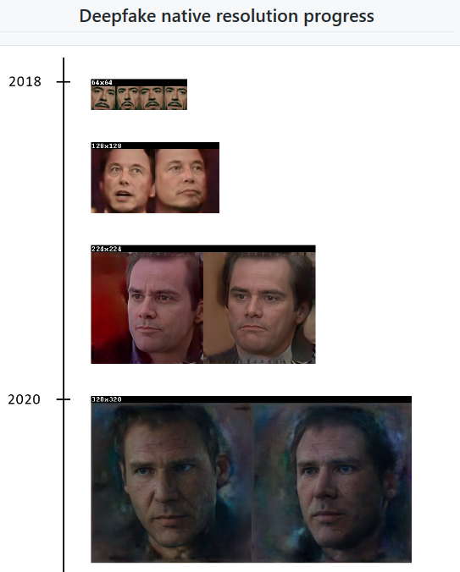

Slide 34
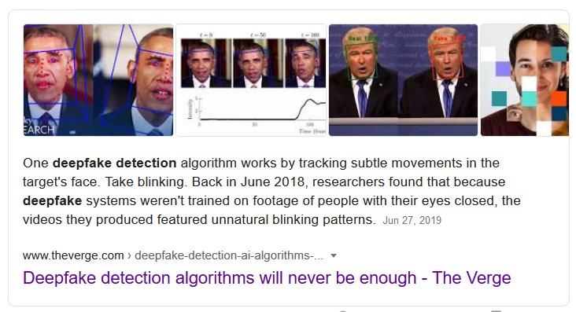
How To Detect Deepfake Images?
Hint: Humans Can’t Do It

Slide 35
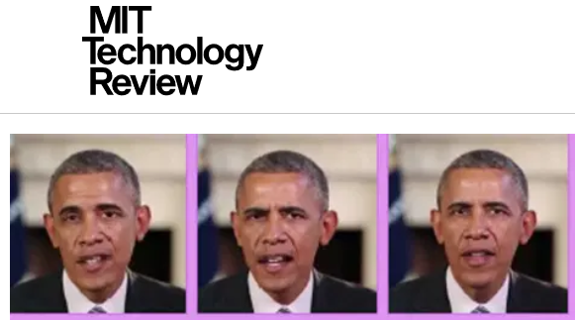

Source: https://www.technologyreview.com/2019/06/21/134815/a-new-deepfake-detection-tool-should-keep-world-leaders-safefor-now/

Slide 36





Slide 37

Source: https://github.com/ondyari/FaceForensics

Slide 38

Source: https://github.com/natanielruiz/disrupting-deepfakes

Slide 39

Source: https://www.amnesty.org/en/latest/news/2020/06/usa-facial-recognition-ban/

Slide 40

Facial Recognition Challenges - London
Source: https://news.sky.com/story/met-polices-facial-recognition-tech-has-81-error-rate-independent-report-says-11755941

Slide 41




Slide 42

Facial Recognition Challenges - Detroit

Slide 43


Source: https://www.nytimes.com/2019/07/08/us/detroit-facial-recognition-cameras.html

Slide 44

Detroit Police Department HQ

Slide 45

Facial Recognition Challenges – Stanford/SF
Source: https://www.nytimes.com/2019/07/13/technology/databases-faces-facial-recognition-technology.html

Slide 46

Source: https://purl.stanford.edu/sx925dc9385

Slide 47

Facial Recognition via Zoom -> Problem?
Source: https://cacm.acm.org/news/238170-a-zoom-flaw-gives-hackers-easy-access-to-your-webcam/fulltext

Slide 48

Source: https://www.wired.com/story/zoom-bug-webcam-hackers/

Slide 49

Source: https://9to5mac.com/2019/07/16/mac-webcam-hijack/

Slide 50


Slide 51


Source: https://xrds.acm.org/article.cfm?aid=3313129

Slide 52


Slide 53

Association of Computing Machinery
https://acm.org

Slide 54

ACM For Students
https://xrds.acm.org/

Slide 55


Slide 56

Week 3 Discussion – NIST Guide

Slide 57

Review ToC, Use Find/Search

Slide 58



Slide 59


Week 3 Lab Assignment

Slide 60


Week 3 Lab Assignment

Slide 61


